Slide 1
Master North Star Playbook
Entity architecture, operating doctrine, acquisition engine, and wealth preservation

Slide 2
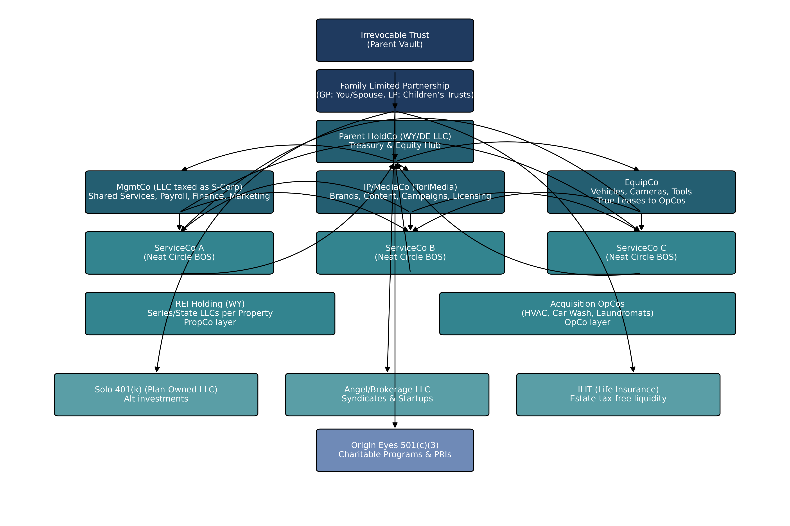
Corporate Structure Flow

Slide 3
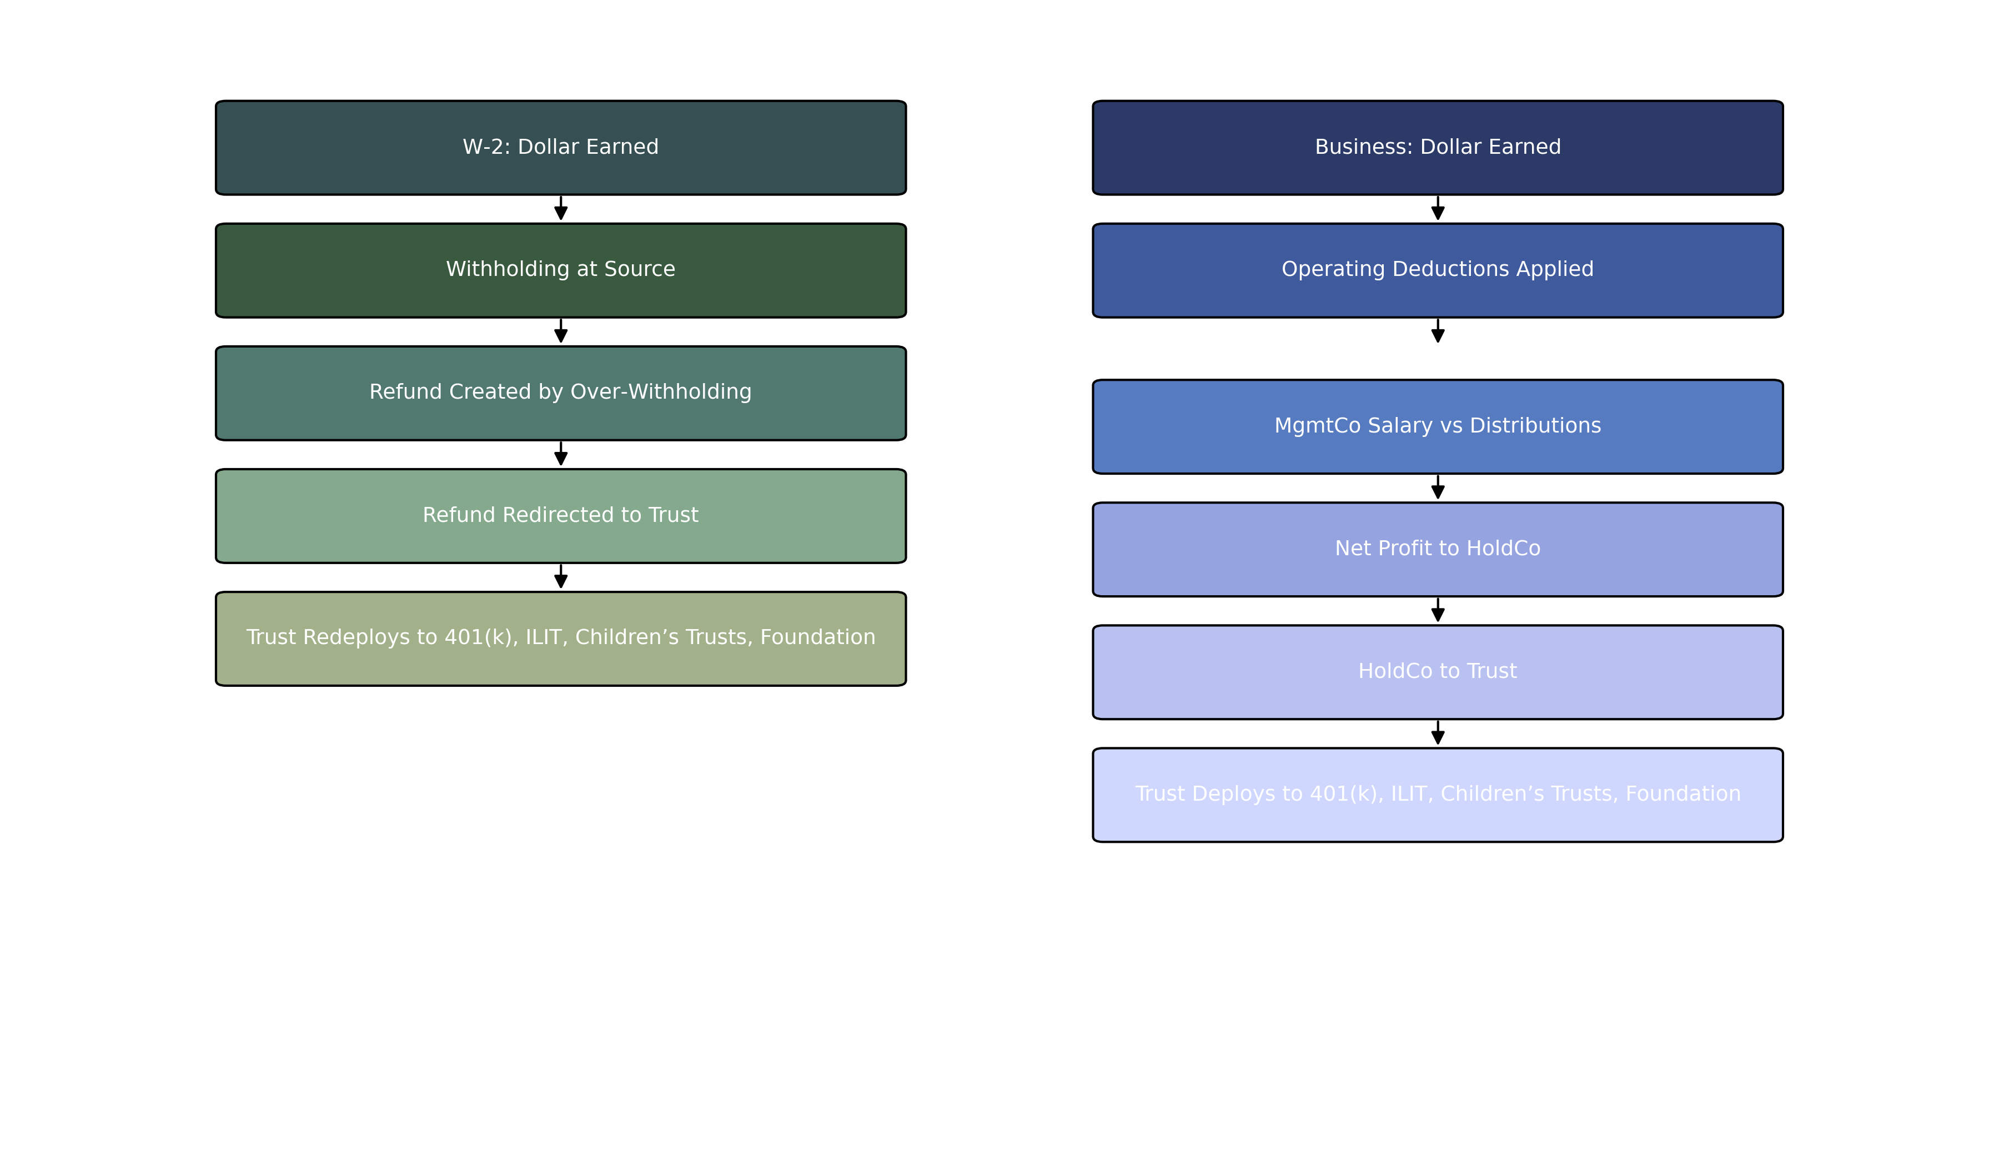
Dollar Flow: W‑2 and Business

Slide 4
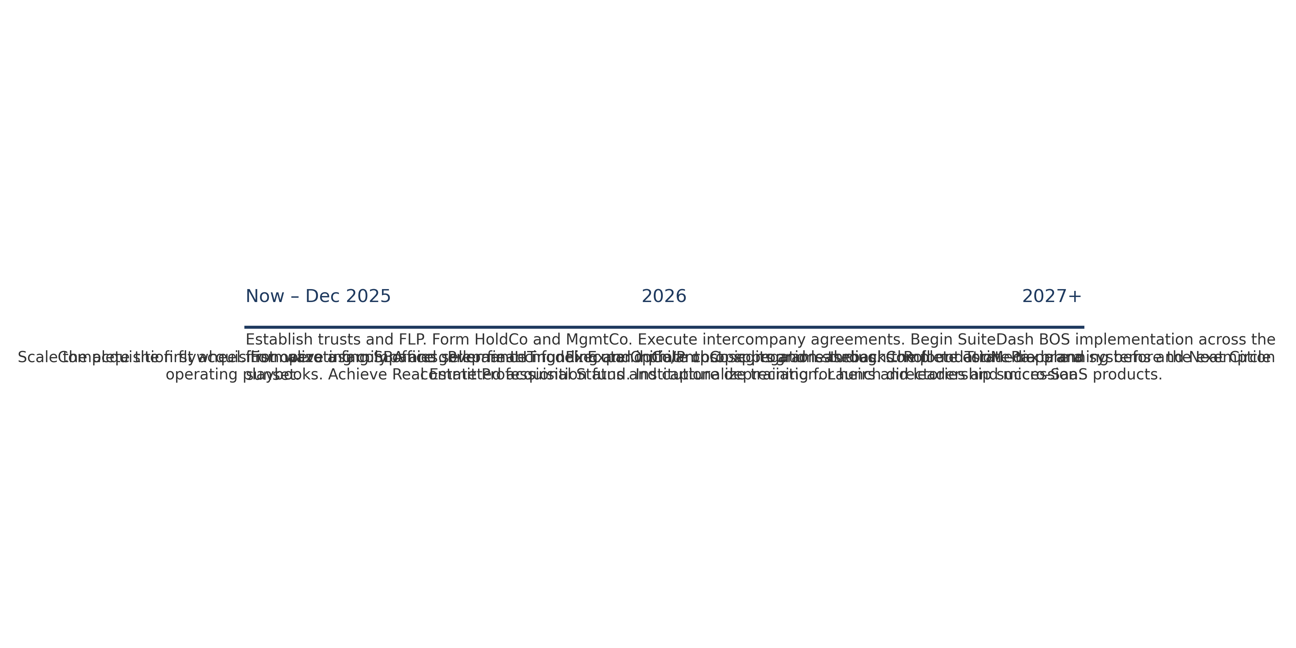
Roadmap Timeline

